Slide 1
SHANGRI-LA Hotel, chengdu

Slide 2
Guest Rooms

Slide 3
GUEST ROOMS
General information
593 spacious guestrooms and suites
26 serviced apartments
Room size from 42sqm – 276sqm
Complimentary wireless Internet access
24hrs Fitness Center

Slide 4
HORIZON CLUB
Horizon Club floors and Executive Suites benefits
Usage of the Horizon Lounge
Daily Breakfasts
Coffee, tea and soft drinks throughout the day
Happy Hour and Afternoon Tea
Use of meeting room for up to 2 hours per day
Pressing of one suit upon arrival
Late check-out till 6:00 pm ( Per Room Availability)
Express check-in & check-out on Horizon Floor

Slide 5
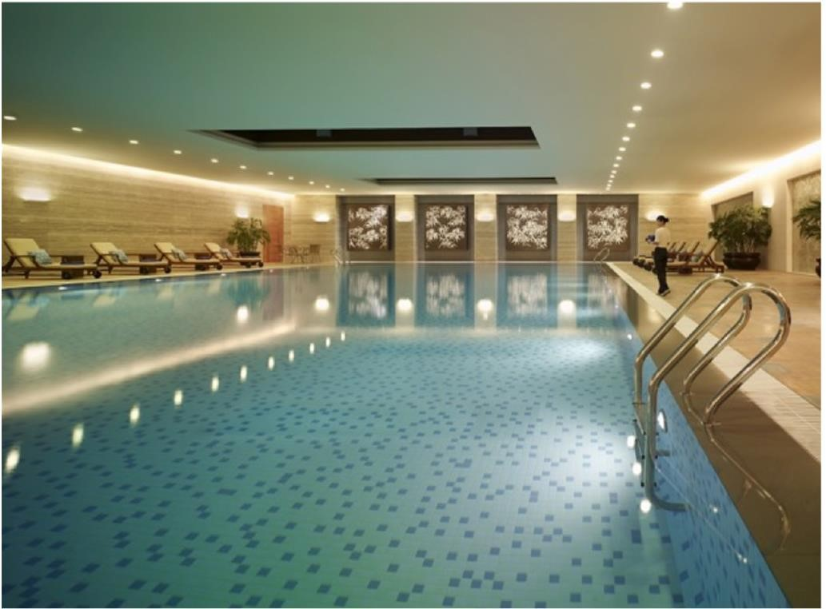
HEALTH CLUB & CHI,THE SPA
Health Club
24 hours superbly equipped
Indoor swimming pool
Sauna, steam bath and massage facilities
Outdoor tennis courts
The gymnasium has an array of cardiovascular equipment along with satellite television
CHI, The Spa
11 luxurious private spa suites
Elegant spa baths and herbal steam facilities
Carefully considered spa ambience creates a refuge with a sense of timelessness

Slide 6
FOOD & BEVERAGE OPTIONS

Slide 7
FOOD & BEVERAGE OPTIONS
Café Z has nine open kitchens offering enticing international buffet and delicate a-la-cart menu.
Shang Palace provides contemporary Cantonese dishes and creative Sichuan cuisine.
Mooney’s Bar and Restaurant features best steaks and ribs in town, and a great beverage menu.
Lobby Lounge boasts the beautiful river view through the signature floor-to-ceiling windows, as the largest of its kind in south-west China.

Slide 8
FUNCTION SPACES
Shangri-La Chengdu owns the largest pillar-less Grand Ballroom in the city center (2,072sqm / 22,300sqi); with direct access via a large lift designed for vehicles or large units, this 8.8 meters height Ballroom can easily split in to three independent parts, together with a 500sqm / 5,380sqi private foyer.
468 Junior Ballroom located on the ground floor is very easy access from a drive way, which it can be split in to two equal parts, together with a 234sqm / 2,520sqi foyer.
Supported by 16 other function spaces size various from 56sqm / 580sqi to 162sqm / 1,740sqi, and a 87 seats auditorium.
All function spaces are equipped with complimentary Wireless Internet access.
Tailor-made themed events

Slide 9
FUNCTION SPACES

Slide 10
FUNCTION SPACES 1F
Jing Guan (Junior Ballroom)
Dimensions
26x18 (m)
Ceiling Height
4.2 (m)
Capacity
Theater: 450
Classroom: 320
Banquet: 280
Foyer
243sqm

Slide 11
FUNCTION SPACES 2F
Ba Shu (Grand Ballroom)
Dimensions
56x37 (m)
Ceiling Height
8.8 (m)
Capacity
Theater: 2000
Classroom: 1320
Banquet: 1200
Foyer
495sqm

Slide 12
FUNCTION SPACES 3F
Ping Le / Le Shan (Function Room)
Dimensions
Ping Le: 16x18 (m)
Le Shan: 16x10 (m)
Ceiling Height
3.2 (m)
Capacity
Theater: 100-120
Classroom: 70-80
Banquet: 70-80
Foyer
76-100sqm

Slide 13
THANK YOU

